Slide 1
Frozen lake agent

Slide 2
Agenda
1. Introduction
2. Problem Definition: Frozen Lake Environment
3. Q-Learning Approach
4. Deep Q-Learning (DQN) Approach
5. Comparison: Q-Learning vs. DQN
6. Results & Performance
7. Conclusion

Slide 3
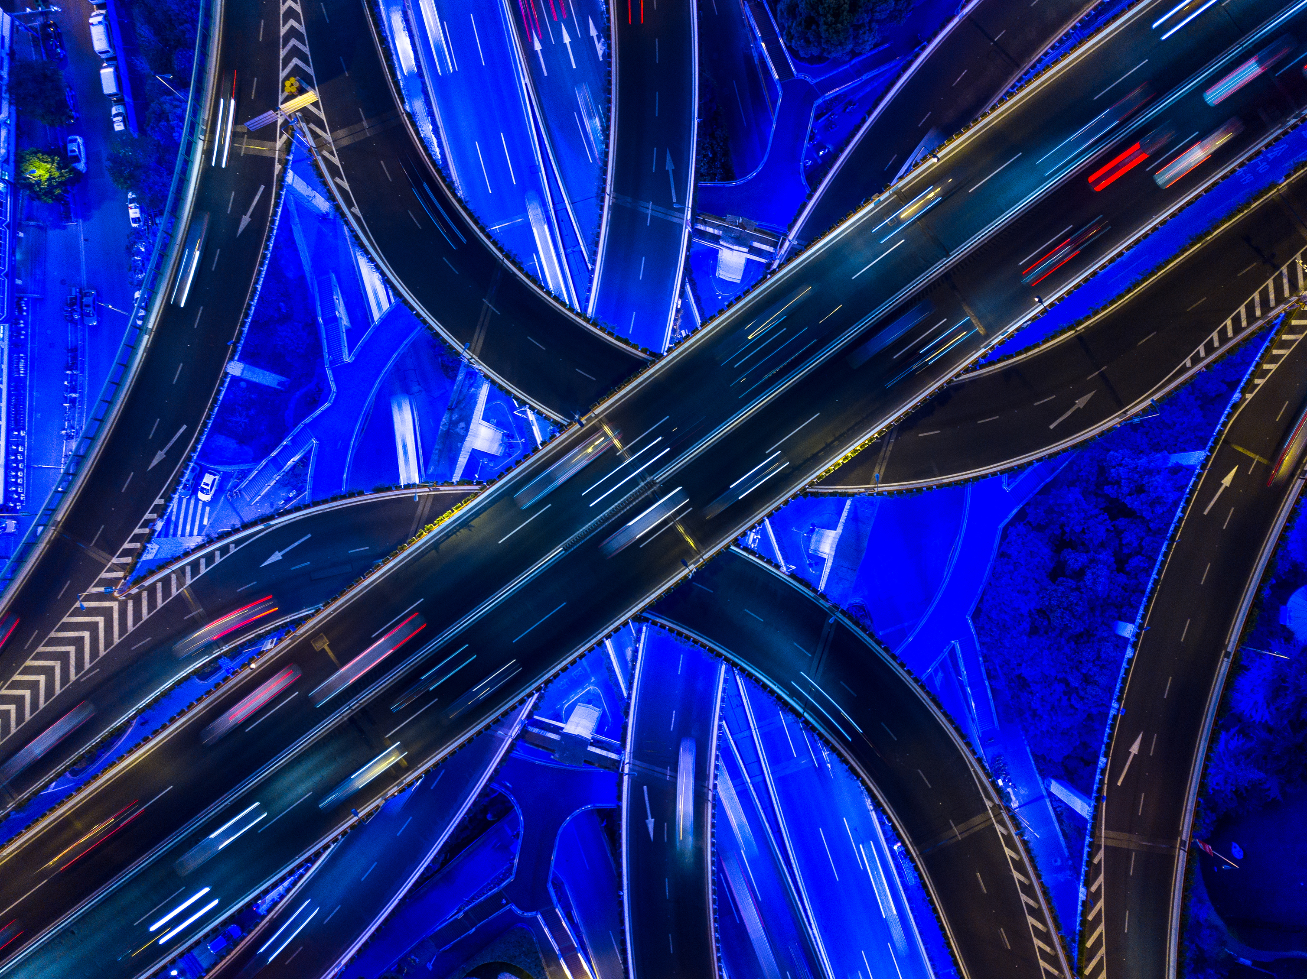
introduction

Slide 4
introduction
Reinforcement Learning (RL) is a machine learning paradigm where an agent learns to make decisions by interacting with an environment. The FrozenLake problem is a classic RL environment in which an agent navigates a slippery 4x4 or 8x8 grid to reach a goal while avoiding holes.
This representation compares Q-Learning (a tabular method) with Deep Q-Learning (DQN) (a neural network-based approach) for solving the FrozenLake environment.

Slide 5
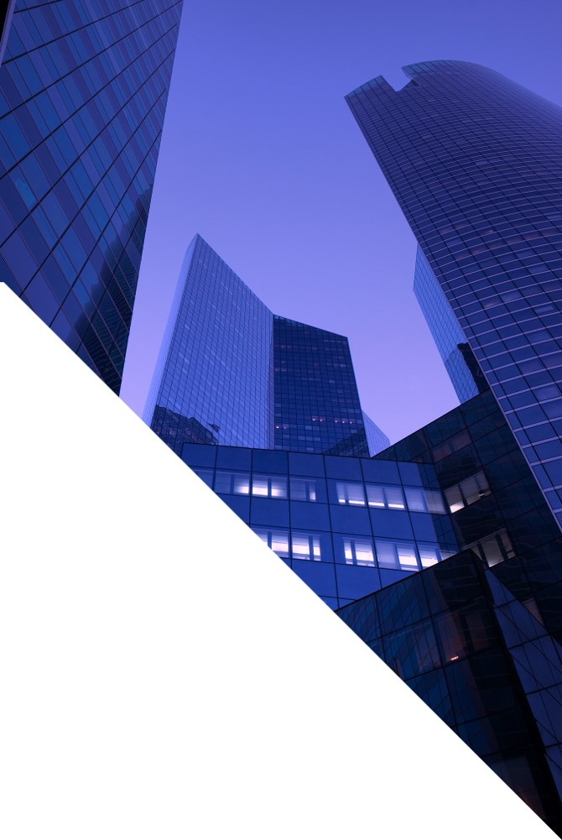
Problem Definition: FrozenLake Environment

Slide 6
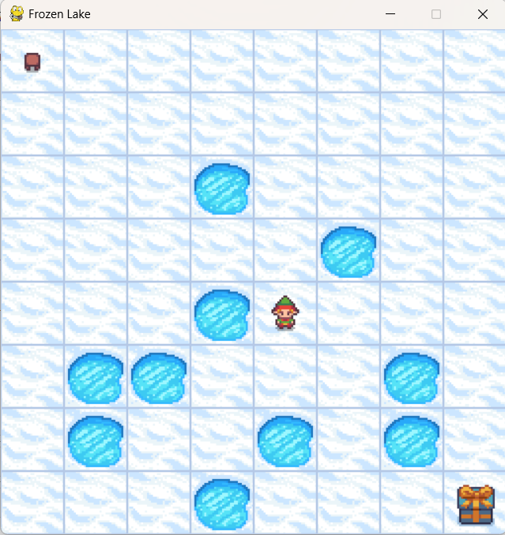
Problem definition
The FrozenLake-v1 environment consists of:A grid-world where an agent moves in four directions: Left (L), Down (D), Right (R), and Up (U).
The goal is to navigate from the start position (S) to the goal (G) while avoiding holes (H).
Rewards:+1 if the agent reaches the goal.
0 otherwise (including stepping onto safe tiles).
The environment can be either:
Slippery: The agent may slip to an unintended tile.
Non-slippery: The agent moves as expected.

Slide 7
Q-Learning Approach

Slide 8
How it work
Q-Learning is a model-free, off-policy reinforcement learning algorithm that uses a Q-table to estimate the expected future rewards for state-action pairs.
Q-Value Update Rule (Bellman Equation)
Q(s,a)←Q(s,a)+α[R+γa′max​Q(s′,a′)−Q(s,a)]
where:
Q(s,a) = Q-value for state s and action a.
alpha = Learning rate (how much new information overrides old knowledge).
R = Reward received for the action.
y = Discount factor (importance of future rewards).
maxa′​Q(s′,a′) = Maximum Q-value for the next state s′.

Slide 9
Implementation step
Initialize Q-table with zeros.
For each episode:
Initialize environment (set agent at start position).
While episode is not terminated:
Choose an action using an ε-greedy strategy:
With probability ϵ\epsilonϵ, select a random action.
Otherwise, select the action with the highest Q-value.
Perform the action and observe:
New state
Reward
Whether the episode has terminated
Update the Q-value using the Bellman equation.
Decrease ϵ\epsilonϵ (exploration decay).

Slide 10
Deep Q-Learning (DQN) Approach

Slide 11
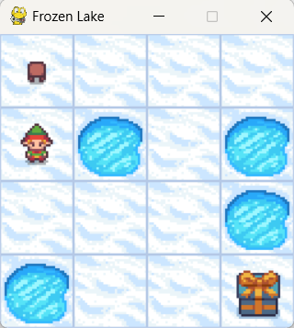
How it work
Deep Q-Learning is an improvement over Q-Learning that replaces the Q-table with a neural network. The neural network approximates Q-values for each state-action pair.
Key Components of DQN
Neural Network: Learns a function Q(s,a) instead of using a table.
Replay Memory: Stores previous experiences (state, action, reward, next state) for training.
Target Network: Stabilizes learning by updating weights periodically.

Slide 12
How it work
DQN Algorithm Steps:
Initialize the neural network (policy network) to estimate Q-values.
Use ε-greedy policy to balance exploration vs. exploitation.
Store agent's experiences (state, action, reward, next state) in a replay memory.
Sample a batch from replay memory and update the neural network using the Bellman equation: Q(s,a)←Q(s,a)+α[r+γmax⁡Q(s′,a′)−Q(s,a)]
Periodically update a target network to improve training stability.
Repeat until convergence or a set number of episodes.

Slide 13
How it work
Neural Network Architecture
The DQN model replaces the Q-table with a feedforward neural network, which takes the state as input and predicts Q-values for all possible actions.
Typical Architecture:
Input Layer: One-hot encoded representation of the state.
Hidden Layer(s): Fully connected layers with ReLU activation.
Output Layer: A linear layer predicting Q-values for all possible actions.

Slide 14
Comparison: Q-Learning vs. DQN

Slide 15
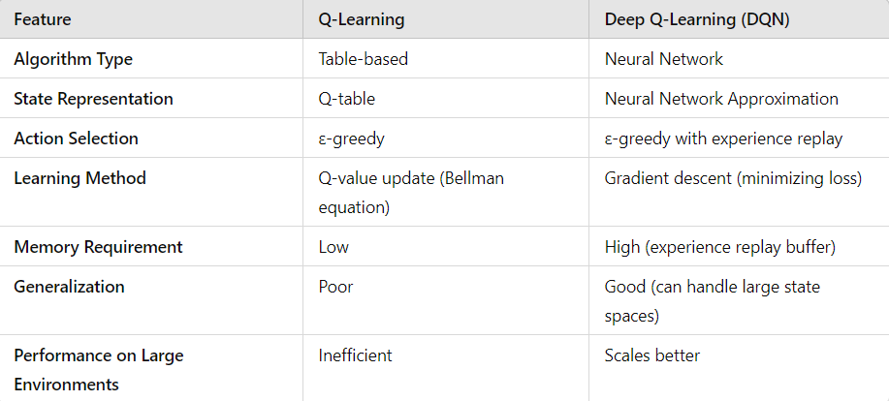
comparison

Slide 16
Results & Performance

Slide 17
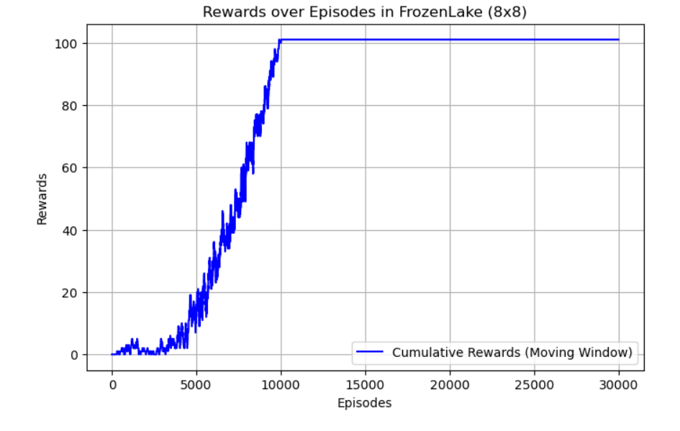
Visualization for q approach

Slide 18
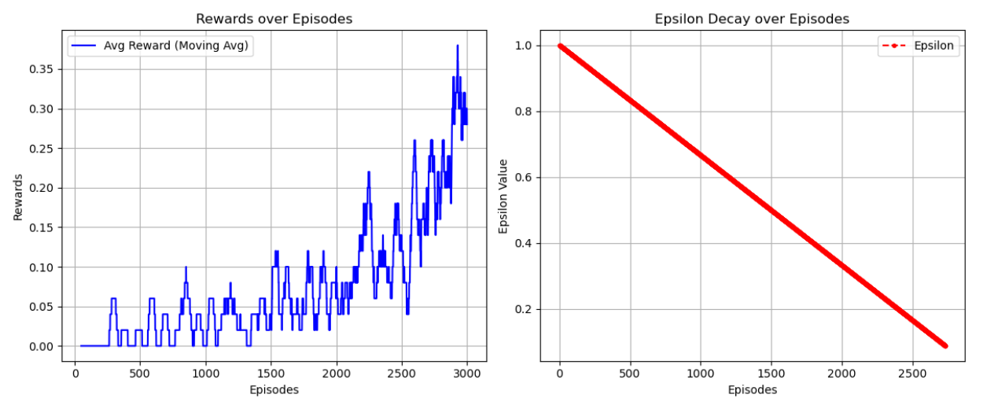
Visualization for dqn approach

Slide 19
Conclusion ​
Q-Learning is simple and effective for small environments.
DQN is better for complex problems but requires more computation.
Both methods show improvement over time but DQN generalizes better.

Slide 20
THANK YOU

